Slide 1
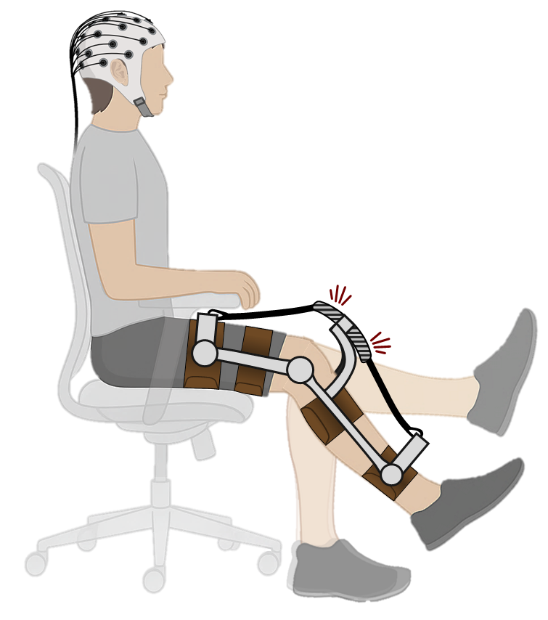
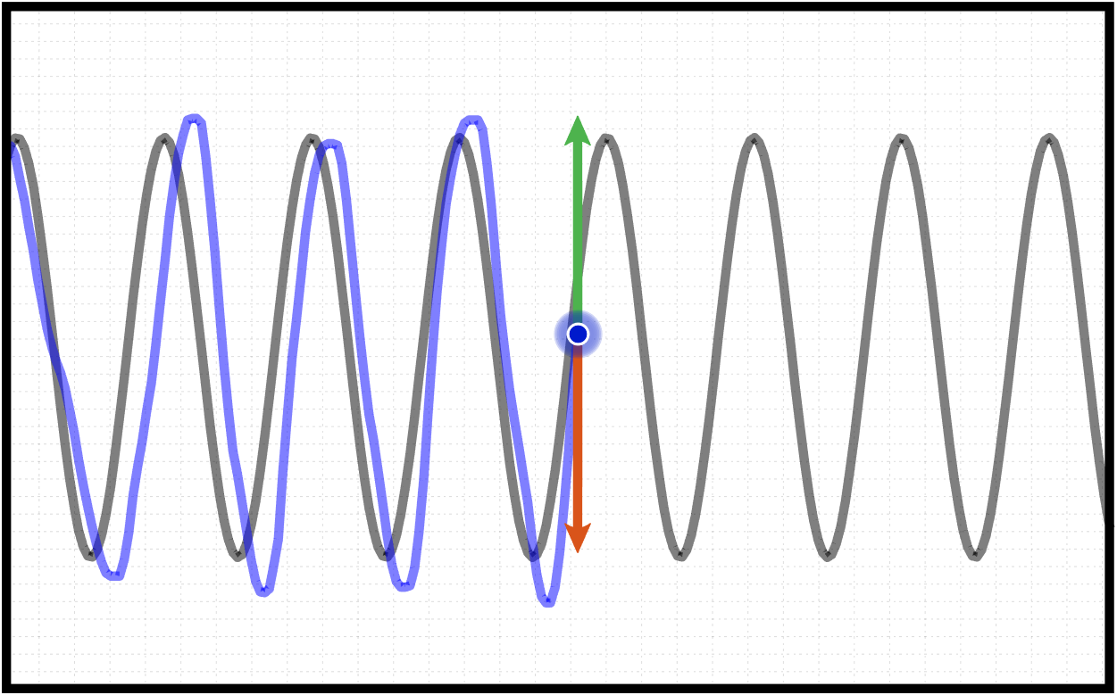
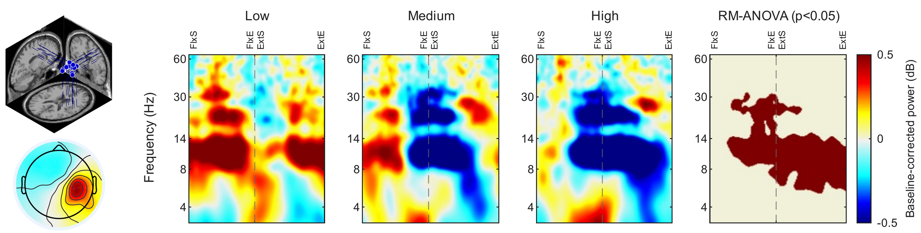
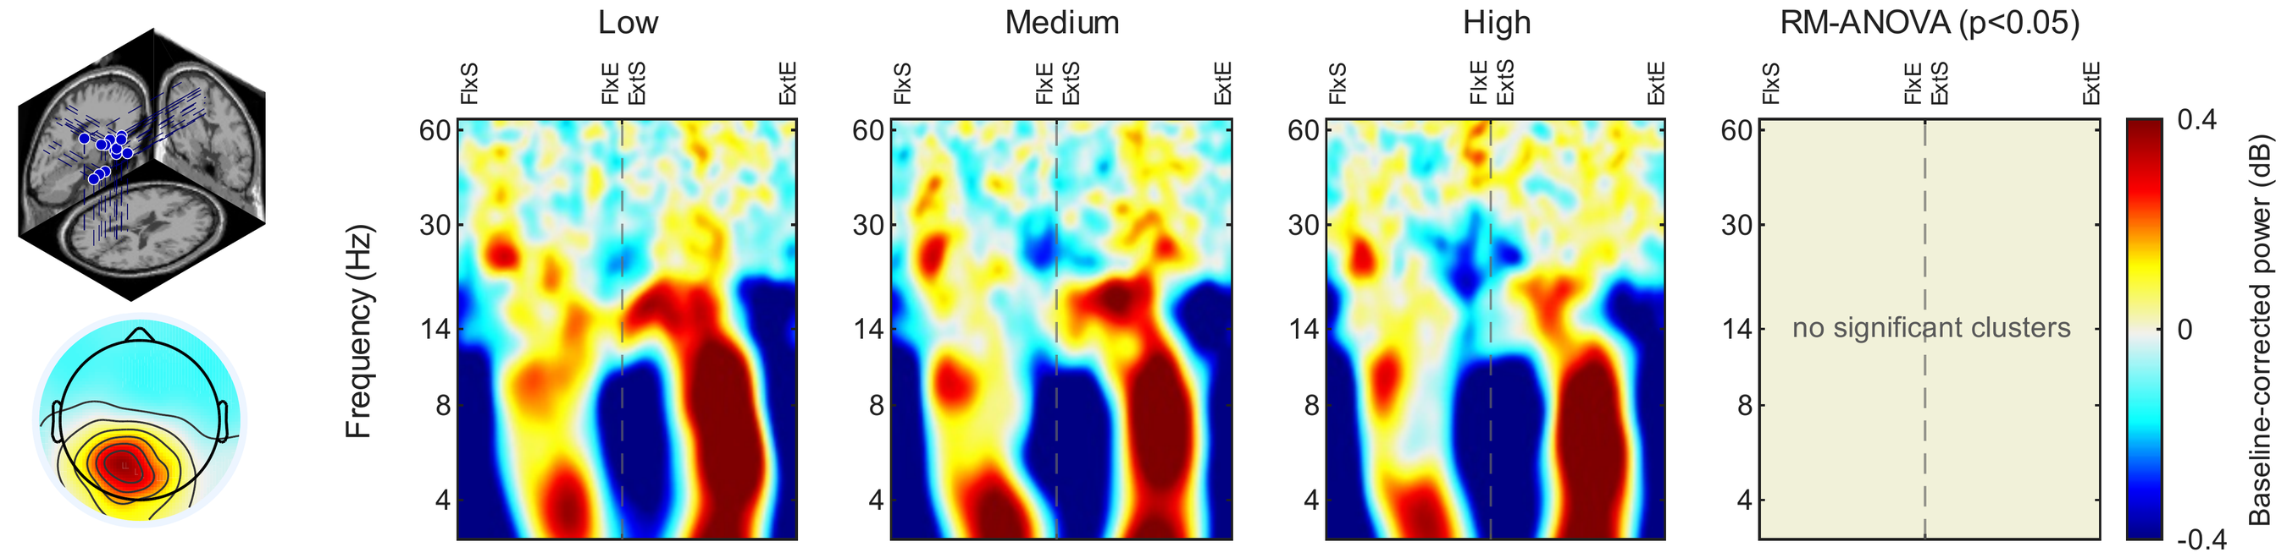
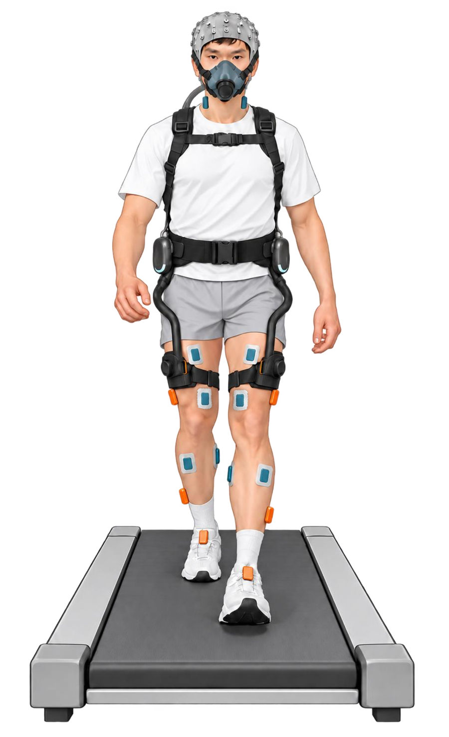
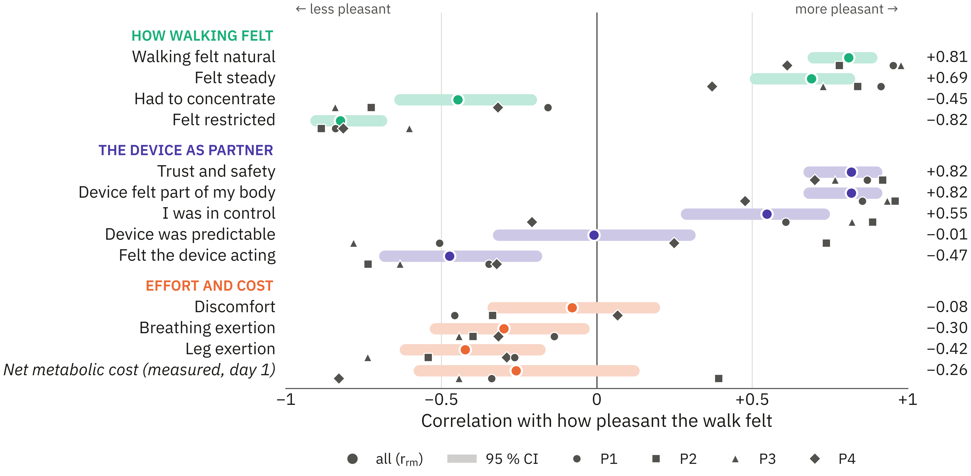
Neuromechanics of Human-Exoskeleton Interaction:
Brain, Body and Experience
Morteza Khosrotabar, Project Area B2, Lauflabor Locomotion Laboratory, TU Darmstadt
Advisors: Prof. Dr. André Seyfarth, Prof. Dr. Klaus Gramann, Dr. Maziar A. Sharbafi
Motivation and Research Challenge
The problem
THE HUMAN COST FUNCTION
Exoskeletons are usually tuned to save energy or muscle activity [1]
But people decide whether to keep a device by how it feels
Which factors do people actually weigh when they judge assistance? We do not know.
Judgement = Σ w_{i} · term_{i}
Scan for the Questionnaire
w_{i} = ?
Why it matters
Which terms matter, and how much, for each person?
A device that saves energy but feels wrong will be rejected
Knowing the user’s own criteria allows assistance that people accept and want to use [2]
Energy
Muscle Effort
Stability
Naturalness
Predictability
Control
My Approach
Current Status
Two studies: what makes a device feel right?
Study 1: knee exoskeleton · paper ready [3]
From a controlled single joint movement to natural walking
A unique regional fingerprint of the physical demand imposed by the exoskeleton on the cortical dynamics
Study 1 · done: knee exoskeleton, seated
Right sensorimotor cortex (n = 12):
Alpha & beta power decrease step by step with demand
Reference Tracking
14 participants
A visuo-motor tracking task while the exoskeleton applies 3 levels of physical demand
EEG, knee flexors and extensors, and subjective evaluations were recorded
Knee Angle
Extension
Ref. Trajectory
Medium
High
Flexion
6 bar
Extension
Horizontally moving reference path
Flexion
Air compressor & Pressure valve
Pressurised
PAM shape
Low demand (P = 1 bar)
Medium demand (P = 3 bar)
Left parieto-occipital cortex (n = 13):
Task-locked modulation in theta & alpha power, independent of the demand
High demand (P = 6 bar)
Study 2 · starting now: hip exoskeleton, walking
Brain: 64-channel mobile EEG
Body: EMG, Kinematics (IMU), GRF, energy cost
Experience: Custom-designed questionnaire
24 participants, 2 days each, 6 modes:
Behaviour: Perceived difficulty increased from 1.8 to 7.0 unit
High
resist
Low
resist
Zero
torque
Low
assist
High
assist
Very high
assist
Muscles 26%
Not explained by muscles or tracking error: 73%
Study 2: hip exoskeleton (pilot, n = 4)
Link to the LokoAssist core ideas
Compared with zero torque, resisting modes raised energy cost by about 10 to 25%; high assistance saved about 5 %
The strongest assistance did not feel like help (3 of 4 rated it as hindering)
Dual evaluation: expert measures (EEG, muscles, energy, gait kinematics) linked to each user’s own judgement
Dual functionality: the exoskeleton assists, and its six modes probe how brain and body respond
What goes with a pleasant walk? How walking felt, not energy
How Could Others Help Me?
How Could Others Benefit From my Research?
I am looking for…
Psychology and human factors: validating short rating scales; agency, embodiment and trust
I can offer…
Repeated-measures correlation [4]; descriptive only
An open dataset: brain, body and experience, different interaction levels
An open questionnaire for your own device study
Our mobile brain/body lab: add EEG and muscle recordings to your study
What remains unclear
Which brain signals carry the judgement, not only the demand?
[1] Sawicki et al. (2020) J NeuroEng Rehabil 17:25. [2] Ingraham, Remy & Rouse (2022) Sci Robot 7:eabj3487. [3] Khosrotabar, Gramann, Seyfarth, Vogt & Sharbafi. Sensorimotor cortex reflects human-exoskeleton interaction level (manuscript). [4] Bakdash & Marusich (2017) Front Psychol 8:456.

